Slide 1

LG: Life’s Good. Student’s Name

Slide 2

Fact 1
LG has been named by the US Environmental Protection Agency (EPA) as a solar energy star on 31st March 2020.
LG has been on the forefront of embracing the switch to solar energy and the efforts have been recognized by EPA.
This recognition means LG is flying high ahead of its rivals in being eco-friendly.
https://www.lg.com/us/press-release/lg-electronics-honored-by-us-epa-as-2020-energy-star-partner-of-the-year

Slide 3
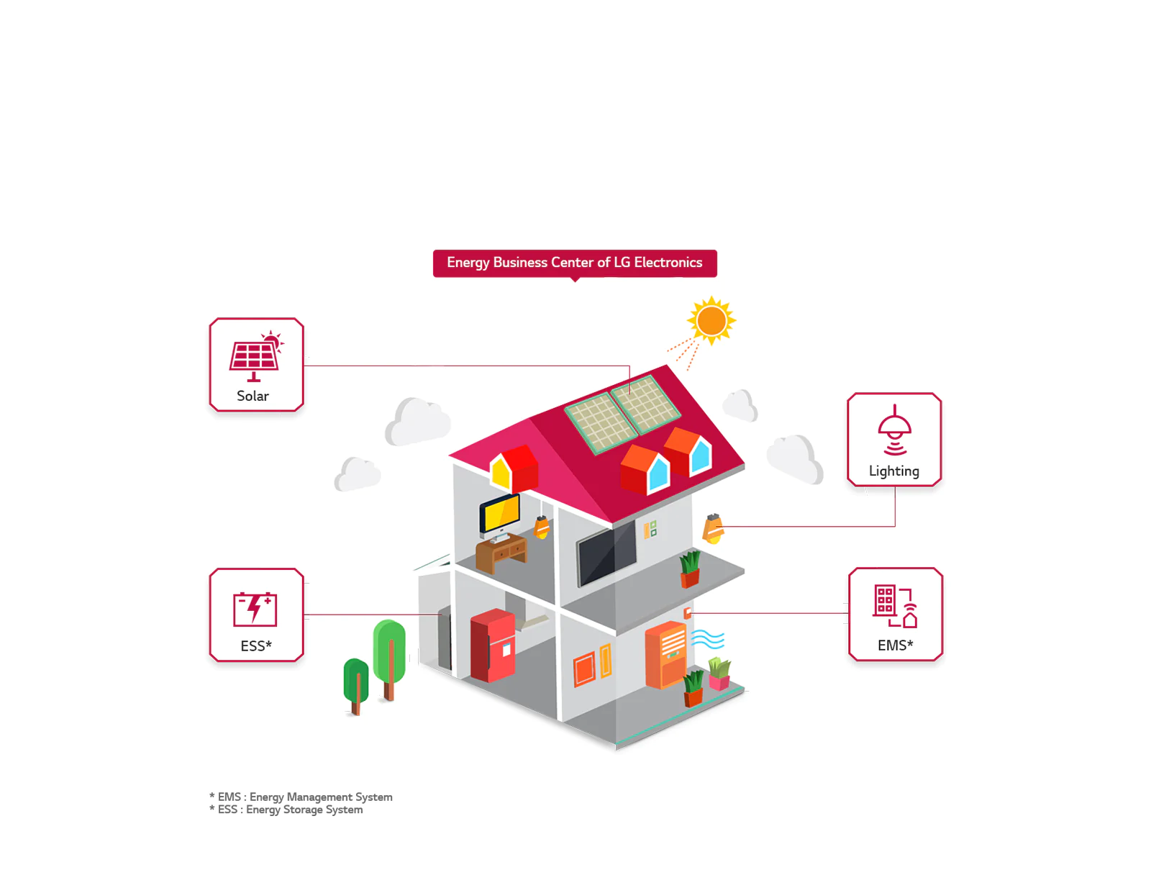
Fact 2
LG has developed a complete energy management system that integrates solar energy production, storage, and control that can be complimented with LG high efficiency appliances.
https://www.lg.com/uk/business/brand-power

Slide 4
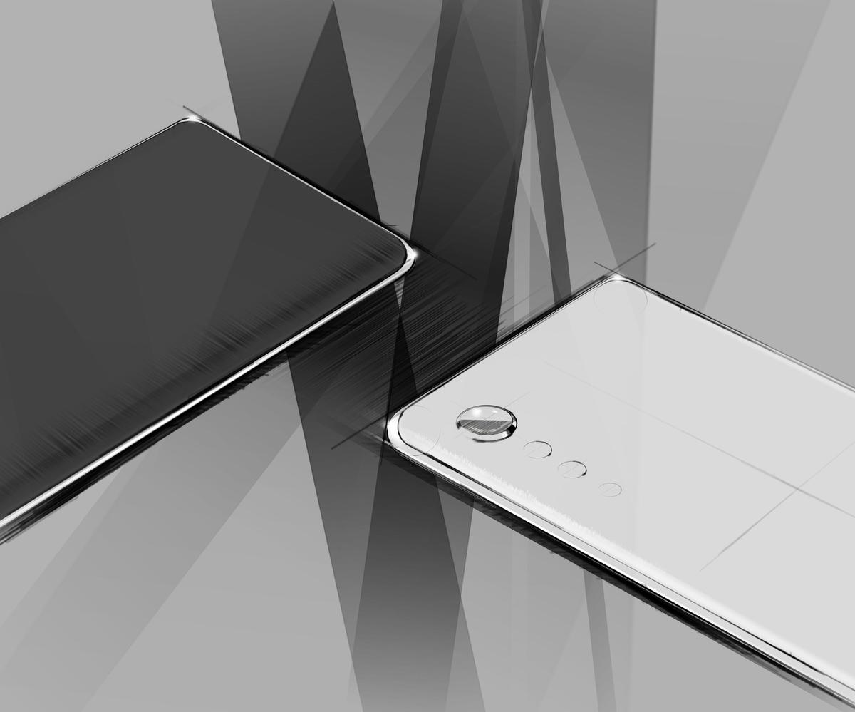
Fact 3
LG Gives Easter Announcement regarding its new Velvet
The Raindorop design is taking the electronic industry by storm and LG seems not to be left behind.
Instead of its traditional big pop cameras, LG is launching Velvet with Rain drop cameras with sleek design.
LG seems to be keen on reviving its concentration on mobile phone production through this Velvet mid-range mobile phone.
https://www.cnet.com/news/lgs-new-velvet-smartphone-to-feature-raindrop-camera/

Slide 5
Fact 4
The new Velvet phone announcement was a shocking one.
LG chose to announce a phone before specifications were known about the phone.
The announcement failed to mention when LG Velvet phone will be launched.
The only striking thing about the announcement was the shift from the traditional pop cameras to a new raindrop camera at the back of the phone.
https://www.cnet.com/news/lgs-new-velvet-smartphone-to-feature-raindrop-camera/

Slide 6
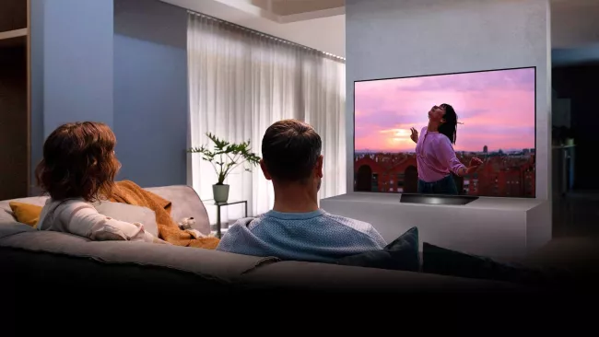
Fact 4
The Korean electronics company LG is largely known for being the primary manufacturer of OLED panels.
LG is the primary manufacturer of the OLED panels used in OLED TVs sold by Sony and Panasonic, too.
In 2020, it is launching a series of TV brands with 8K video capabilities, the highest of its kind.
https://www.techradar.com/news/lg-tv-2020-lineup

